Slide 1
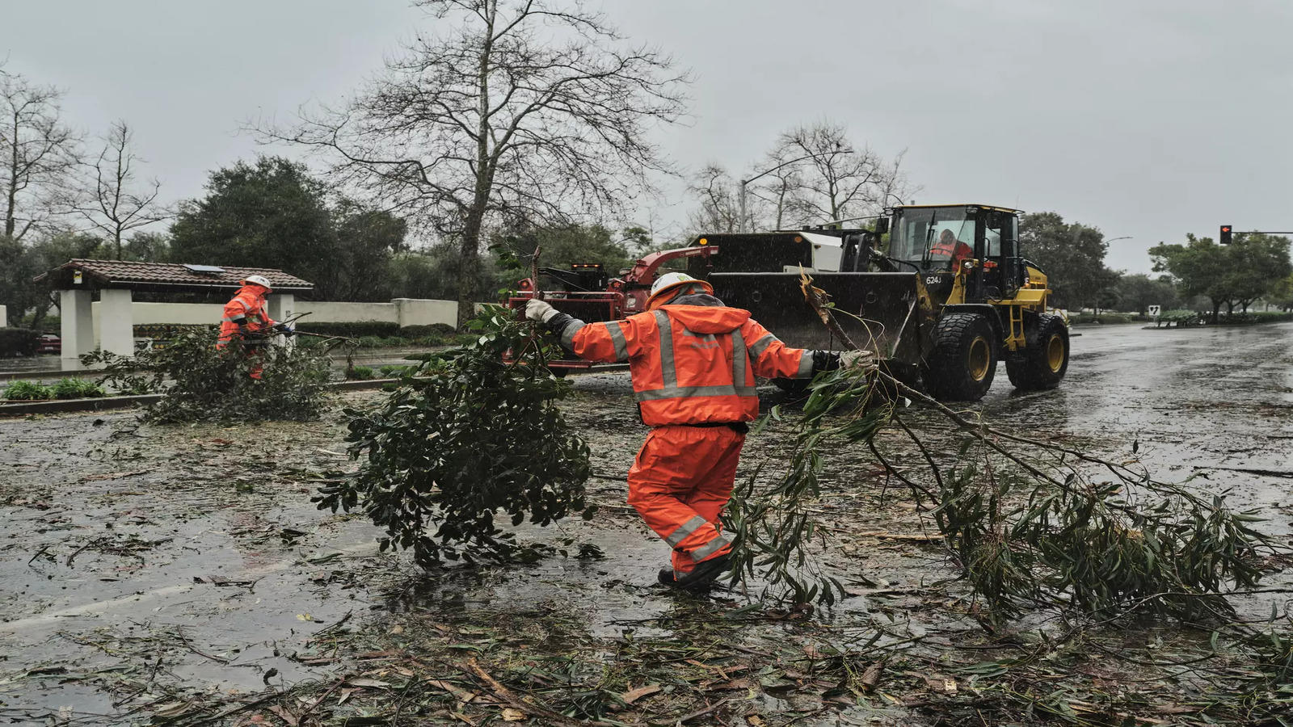
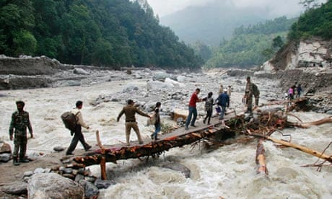
Flood Prediction using Machine Learning
Flood Prediction using Machine Learning
Tech Titans
Tech Titans

Slide 2
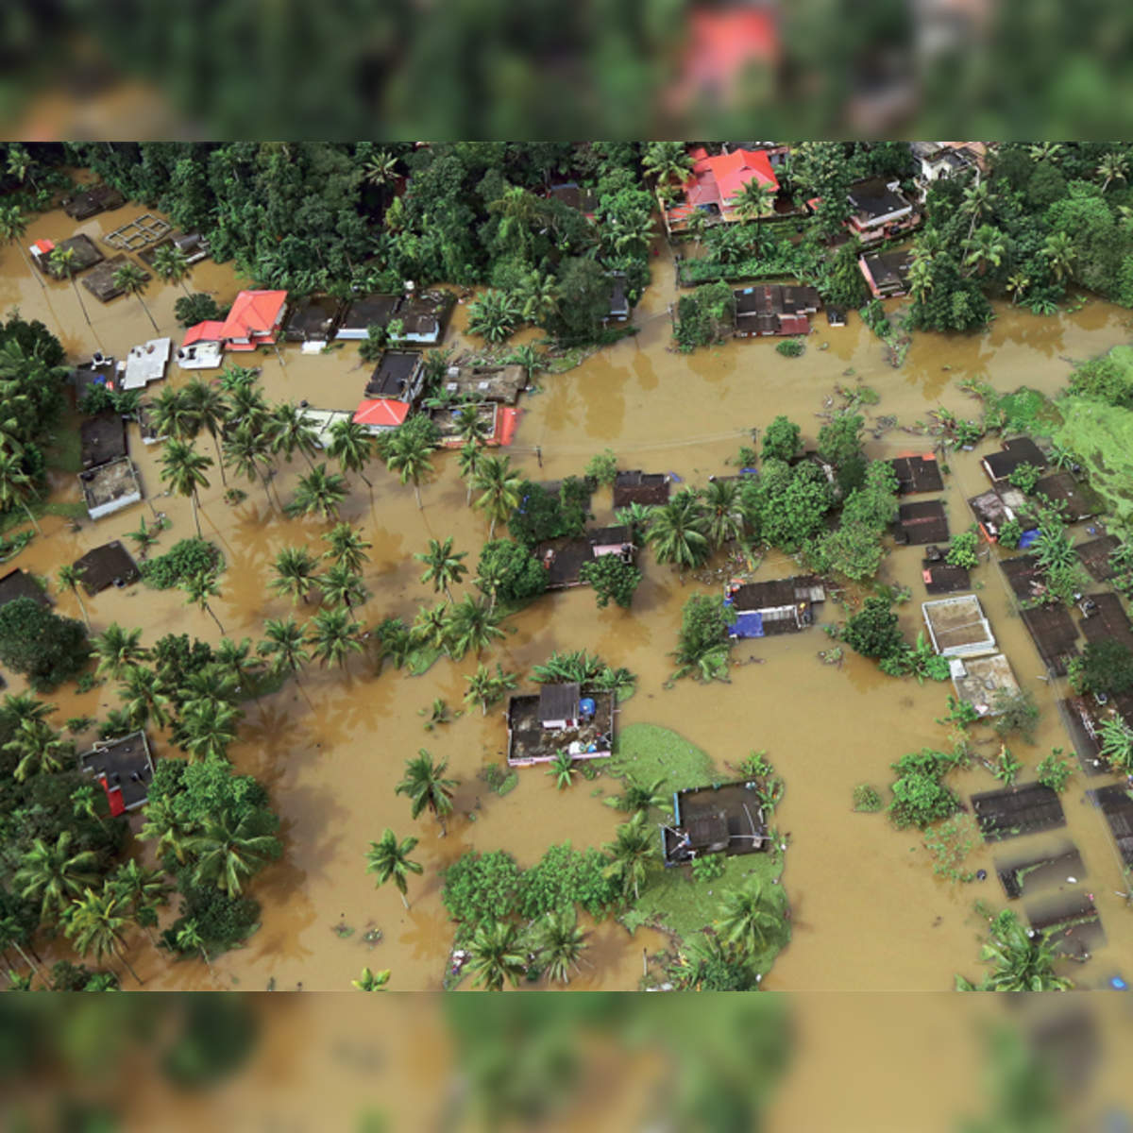
AGENDA
Problem statement
Project Overview
Why we need this
Who are the end users
Solution & its Value Proposition
Solution
Required technology
Modeling
Live demo
Results
Thanks

Slide 3
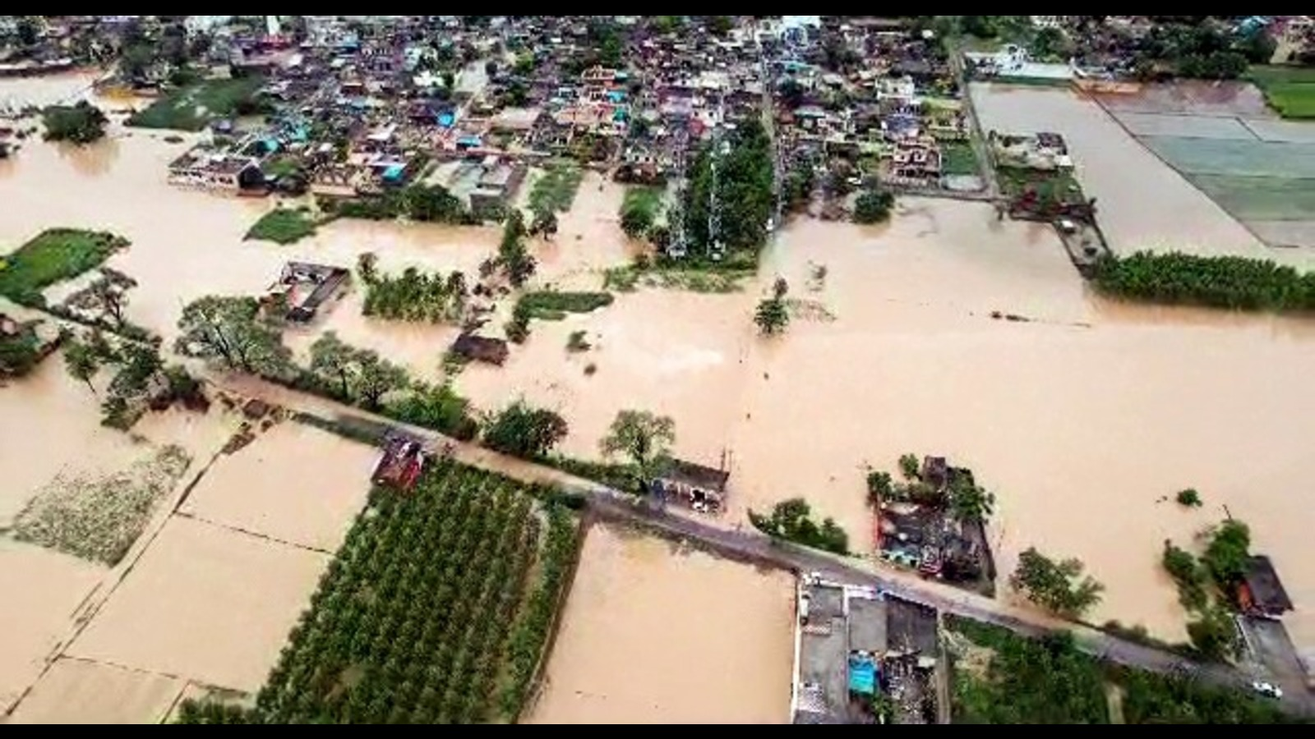
Problem Statement
Increasing frequency of severe floods
Devastating impacts on lives and property
Current prediction methods are insufficient
Need for more accurate and timely predictions
Integration of advanced technology is essential

Slide 4
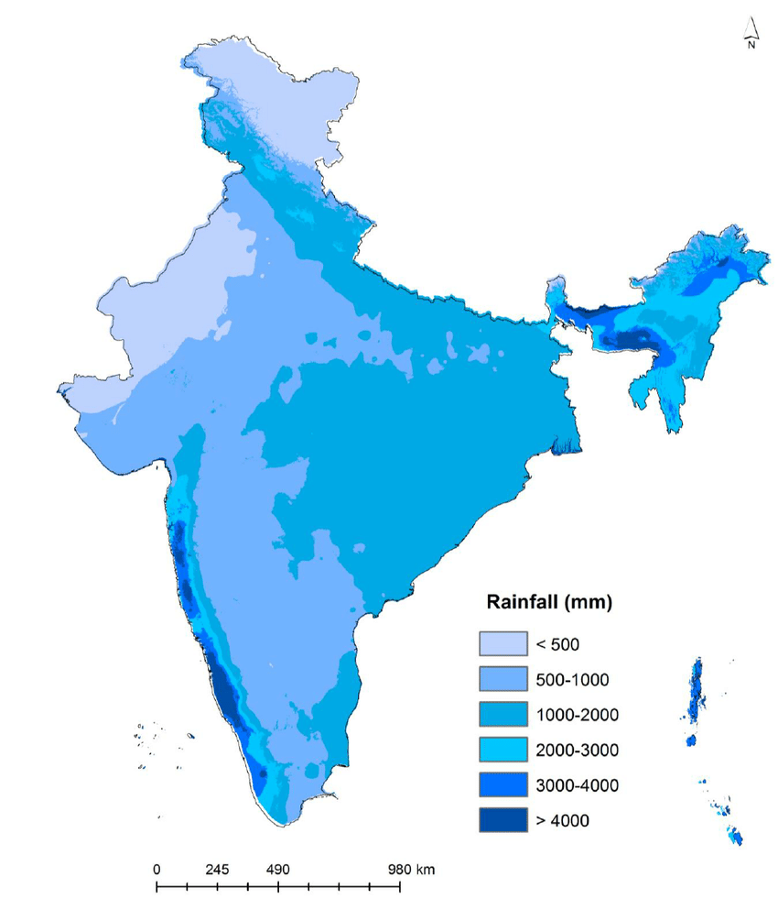
PROJECT OVERVIEW
Development of a flood prediction system
Utilization of machine learning algorithms
Data collection from various sources (weather, river levels, etc.)
Real-time analysis and prediction
Implementation through a user-friendly website

Slide 5
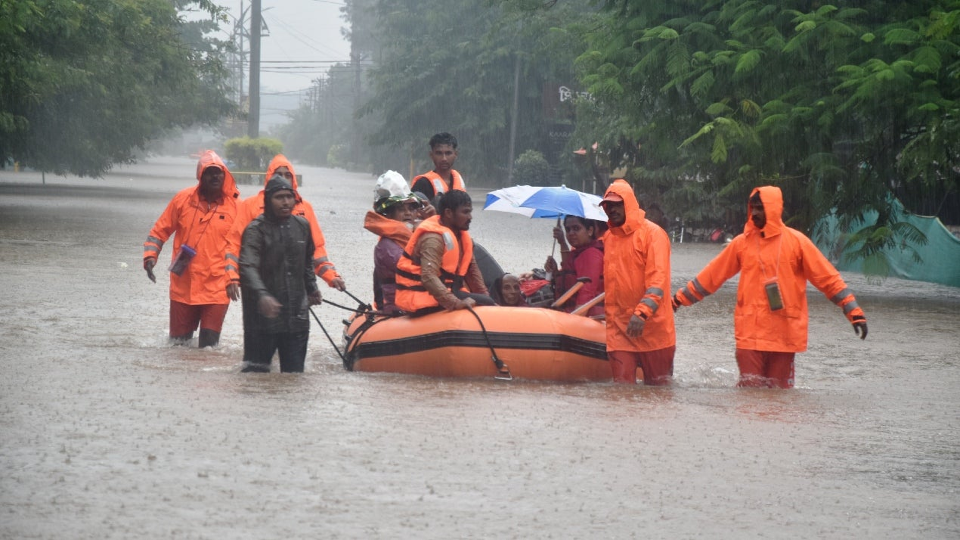
Why We Need This?
Reduce loss of life and property damage
Enhance preparedness and response time
Provide accurate and reliable predictions
Support disaster management agencies
Improve community resilience to floods

Slide 6
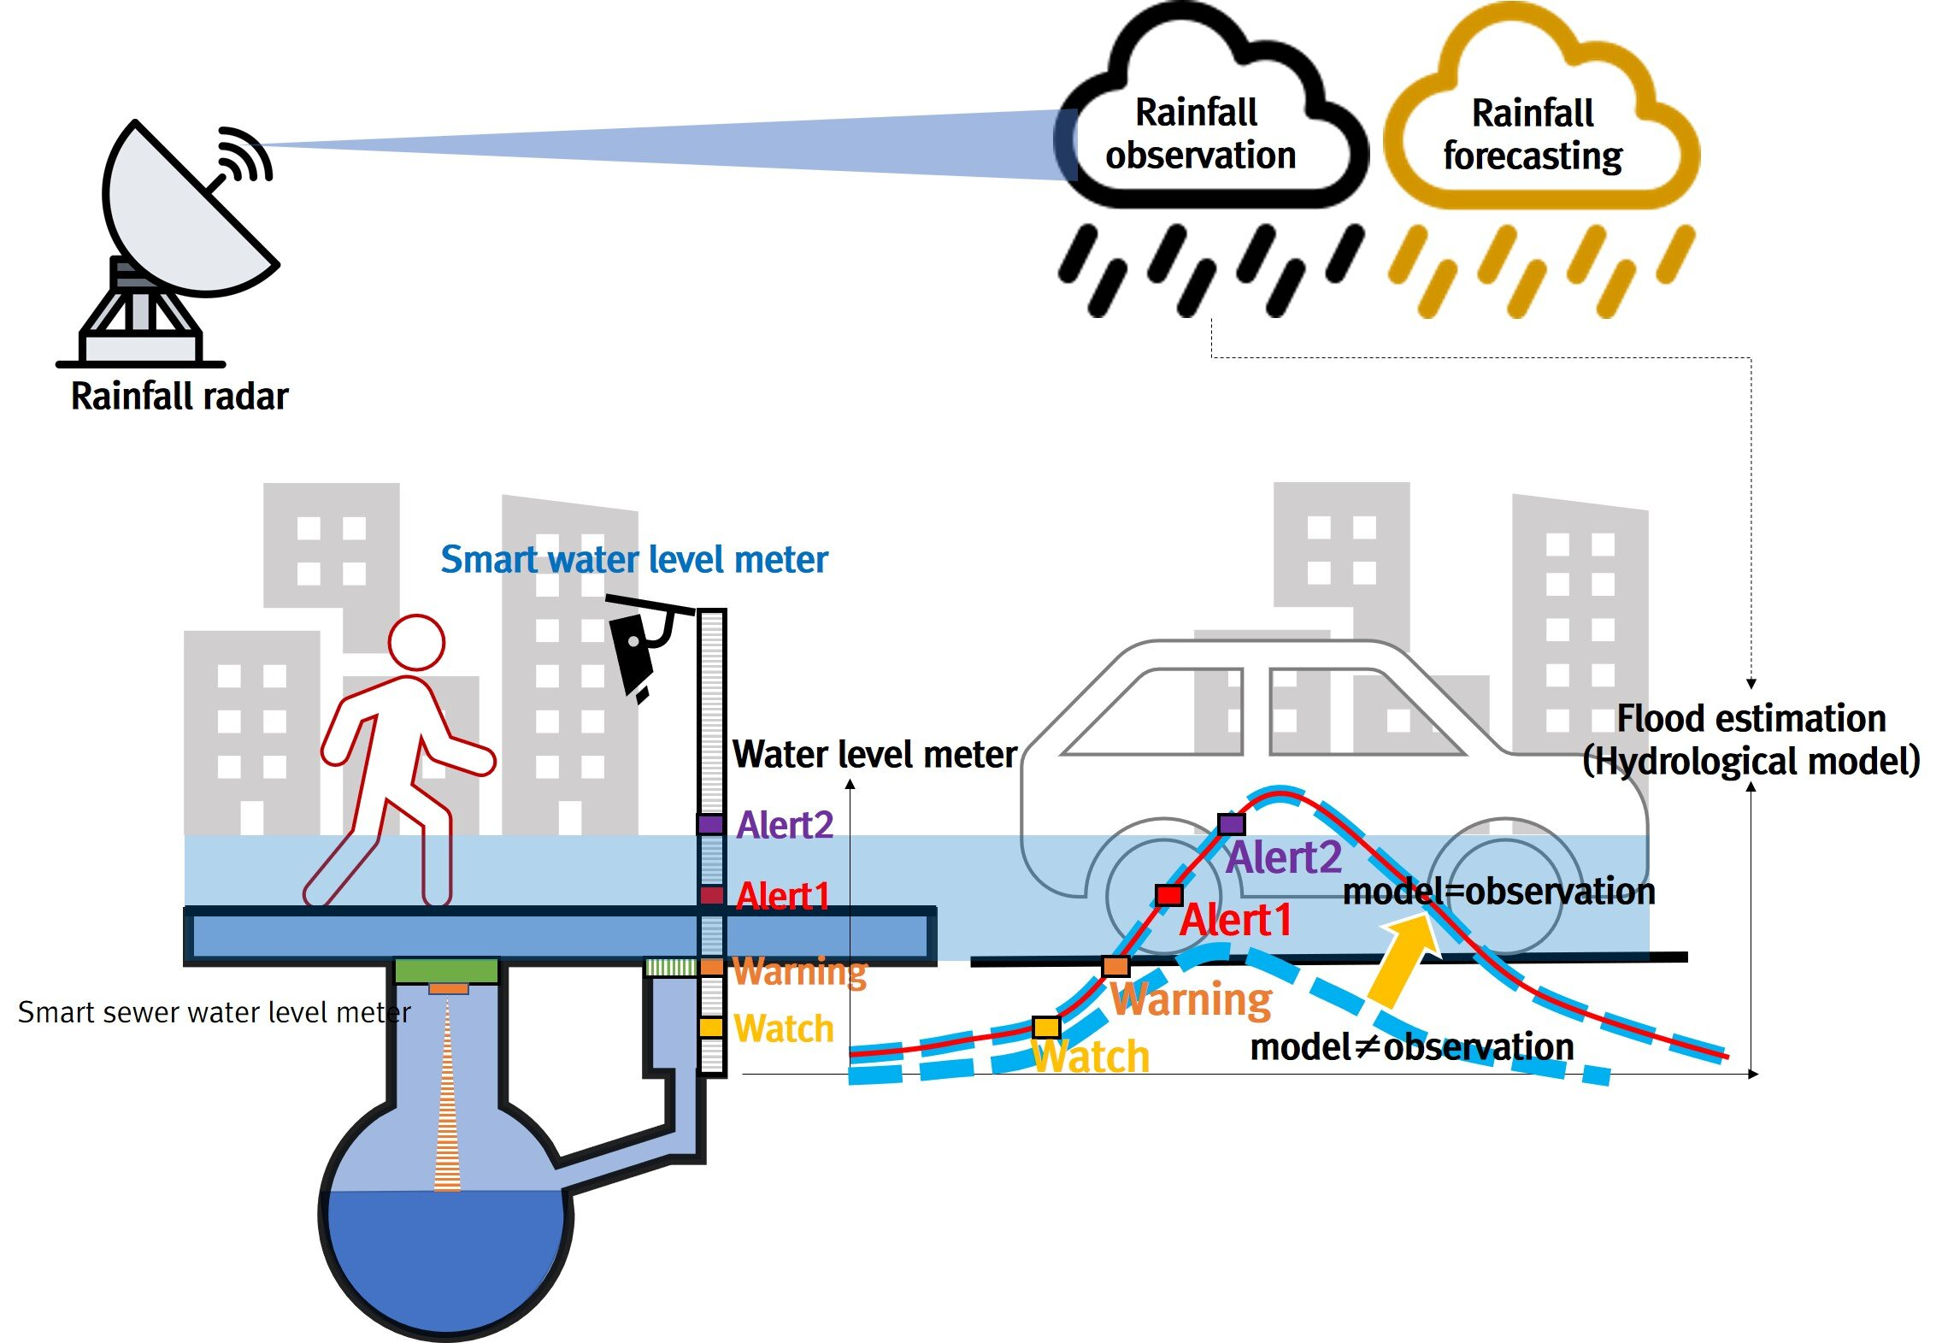
Who are the end users?
Homeowners and property owners in flood-prone areas
Farmers and agricultural producers
Public health officials
Environmental organizations
Local governments
Researchers and academics
Tourism and travel industry professionals
Media outlets

Slide 7
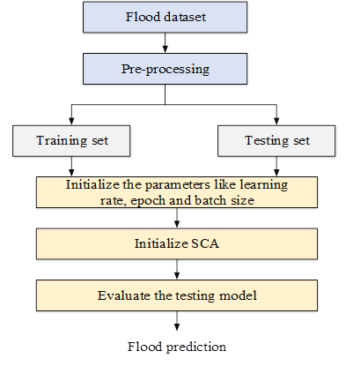
Value Proposition
Improved accuracy of flood predictions
Faster response time for emergency services
Reduction in flood-related damages
Positive user feedback and community impact
Continuous improvement based on real-world data

Slide 8
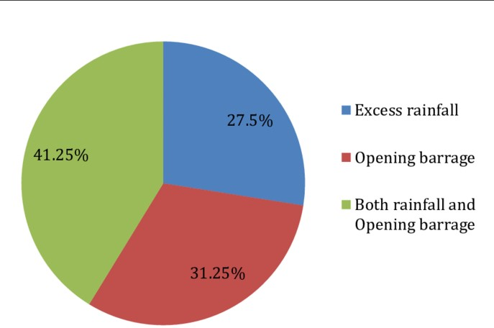
Solution
Machine learning models for accurate predictions
Data integration from multiple sources
User-friendly website for accessing predictions
Real-time alerts and updates
Scalable system adaptable to different regions

Slide 9
Required Technology
Machine learning algorithms
RANDOM FOREST,
NEURAL NETWORK,
SCIKiT-LEARN
DECISION TREE,
RNN,CNN,
REGRESSION,
K-NEAREST NEIGHBOURS(KNN)
Web development technologies
HTML
CSS
JAVASCRIPT
BOOTSTRAP

Slide 10
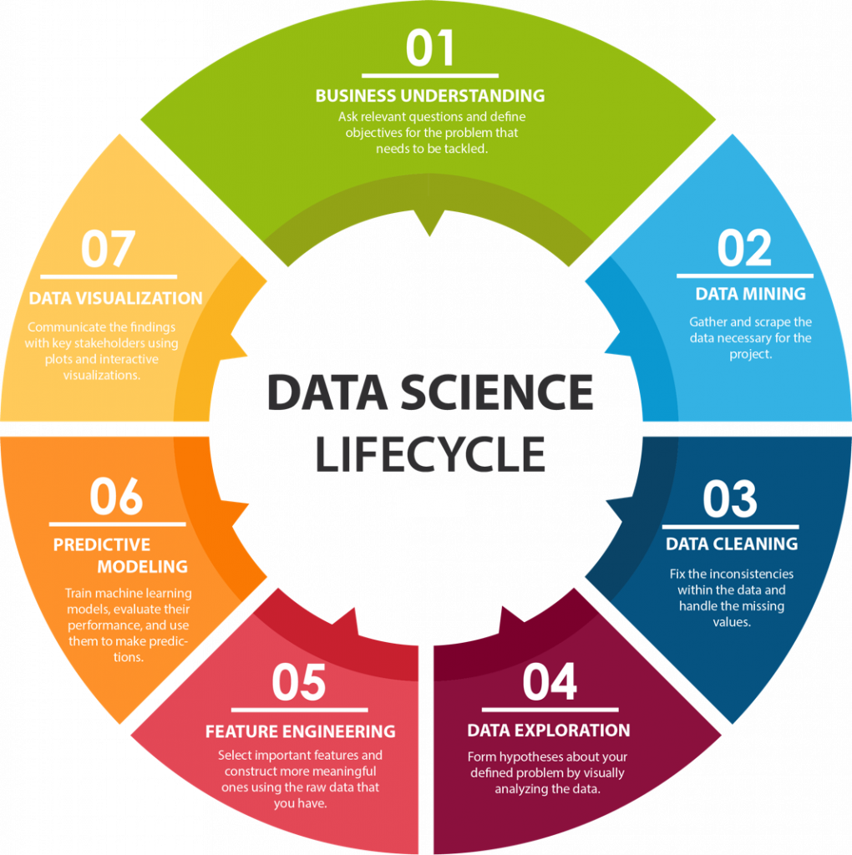
Modeling
Data collection and preprocessing
Feature selection and engineering
Training and validating machine learning models
Model evaluation and optimization
Integration of model into the website

Slide 11
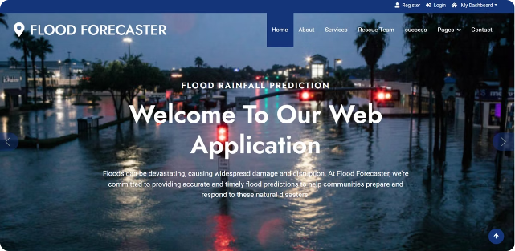
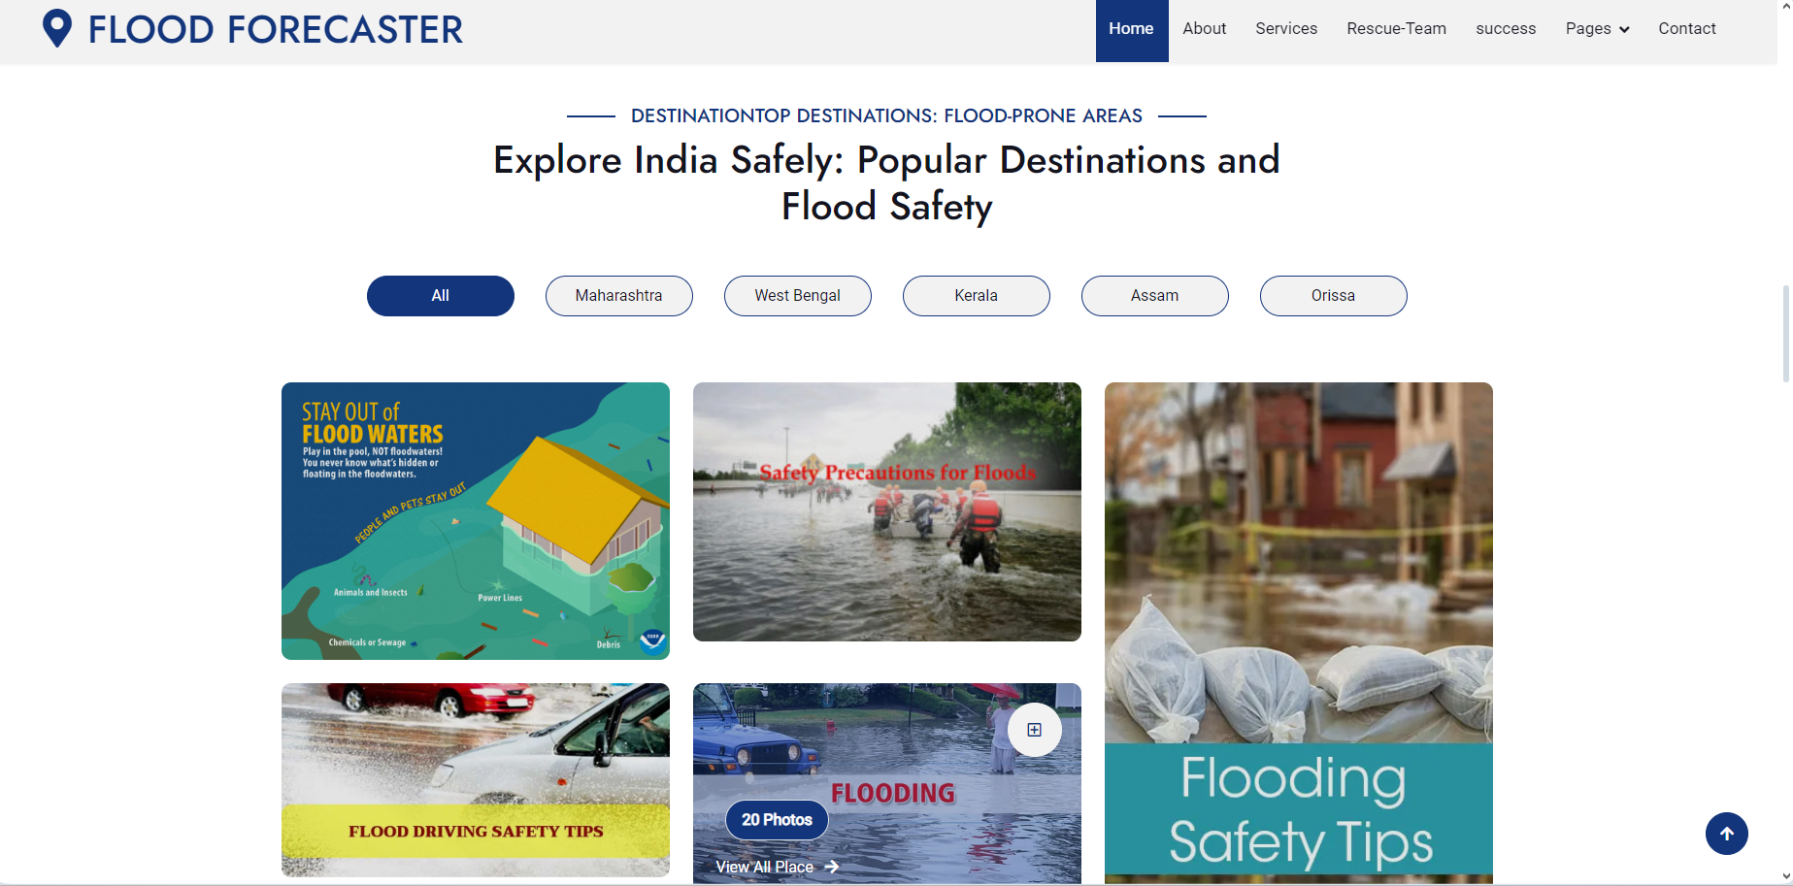
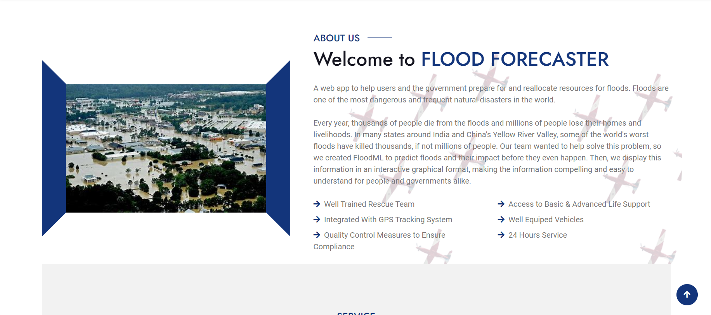
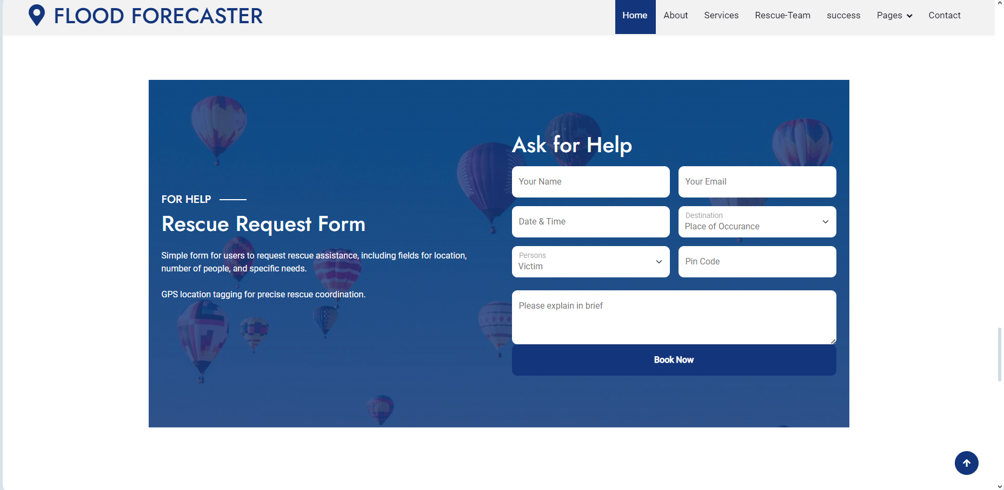
Results

Slide 12
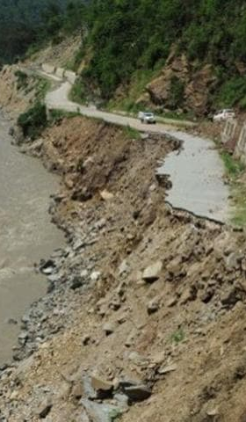
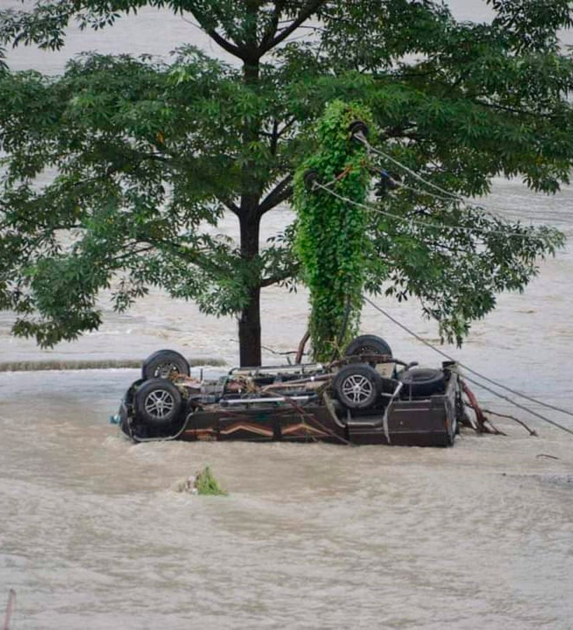
Conclusion
Flood prediction system by Flood Forecaster: Demonstrates the effectiveness of machine learning in addressing real-world problems
.Utilizes various data sources: Leverages historical data, real-time information, and advanced algorithms
.Improved preparedness: Enhances the ability of places to manage flood challenges
.Protects lives and property: Aims to safeguard communities and infrastructure.
Global impact: Sets a precedent for innovative disaster management solutions worldwide.

Slide 13
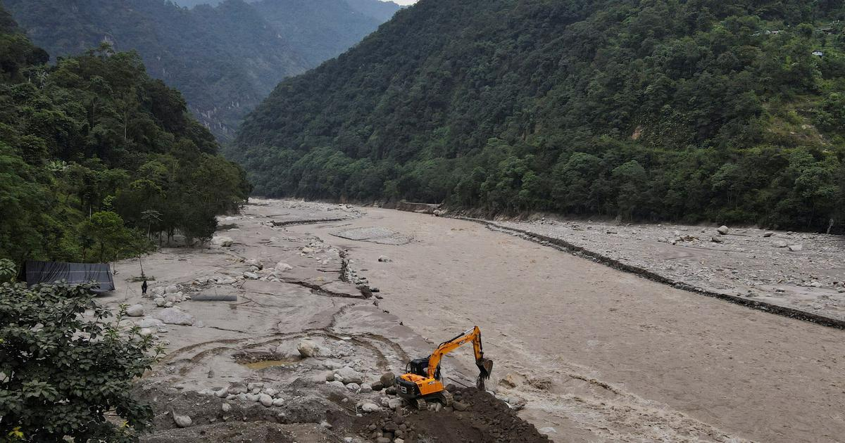
THANK YOU

